Slide 1

SPACE++
Alamedin Sabit & Jeet Jani

Slide 2
The Challenge
Create an application showcasing Canadian spacecraft in orbit.
The Problem
The Question
The Gap
Canada has 30+ active satellites, but this information isn't easily accessible to the public.
Do you know the status and location of these spacecraft? For most people, the answer is no.
No simple, centralized, public-facing tool exists to visualize these national assets in real-time on an interactive 3D globe.

Slide 3

Our Solution: SPACE++
What It Is
01
02
A web application providing, interactive 3D visualization of active Canadian satellites.
Fetch
Calculate
Pull Two-Line Element (TLE) orbital data from Celestrak and Space-Track in JSON document.
Backend processes data to calculate exact current position (latitude, longitude, altitude) of each satellite.
03
Visualize
Frontend plots positions on an interactive 3D globe, updated in stored data
Significance: Our solution directly answers the challenge by demystifying complex data, making Canada's orbital presence accessible and engaging for everyone.

Slide 4

Architecture & Technology
Backend
Frontend
Jeet Jani
Alamedin Sabit
Tech: Flask (Python)
Tech: Next.js and Three.js
Stores TLE data from Celestrak, Space-Track, and other online sources in JSON documents
Next.js handles the web application framework and user interface components
Uses SGP4 orbital mechanics library to calculate current satellite positions
Three.js renders the interactive 3D globe and satellite visualizations
Emits/Publishes the data to frontend using a websocket
Real-time updates via websocket connection to display live satellite positions
Responsive design for optimal viewing across different devices

Slide 5

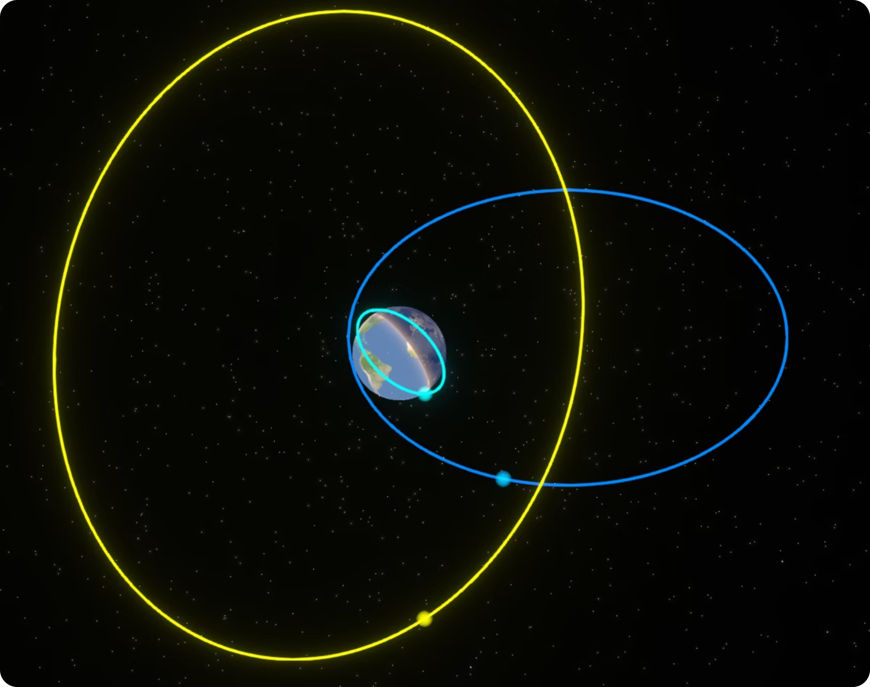

Demo & Results
1
We Built It
Working application successfully visualizes Canadian satellites in real-time.
2
Problem-Solution Coherency
Final solution directly accomplishes showcasing Canadian spacecraft in orbit.
3
Interactive 3D Globe
Clean, intuitive interface for exploring satellite positions.
4
Real-Time Plotting
Live updates showing the entire Canadian satellite fleet.
SatelLocator - Orbit Path Viewer

Slide 6
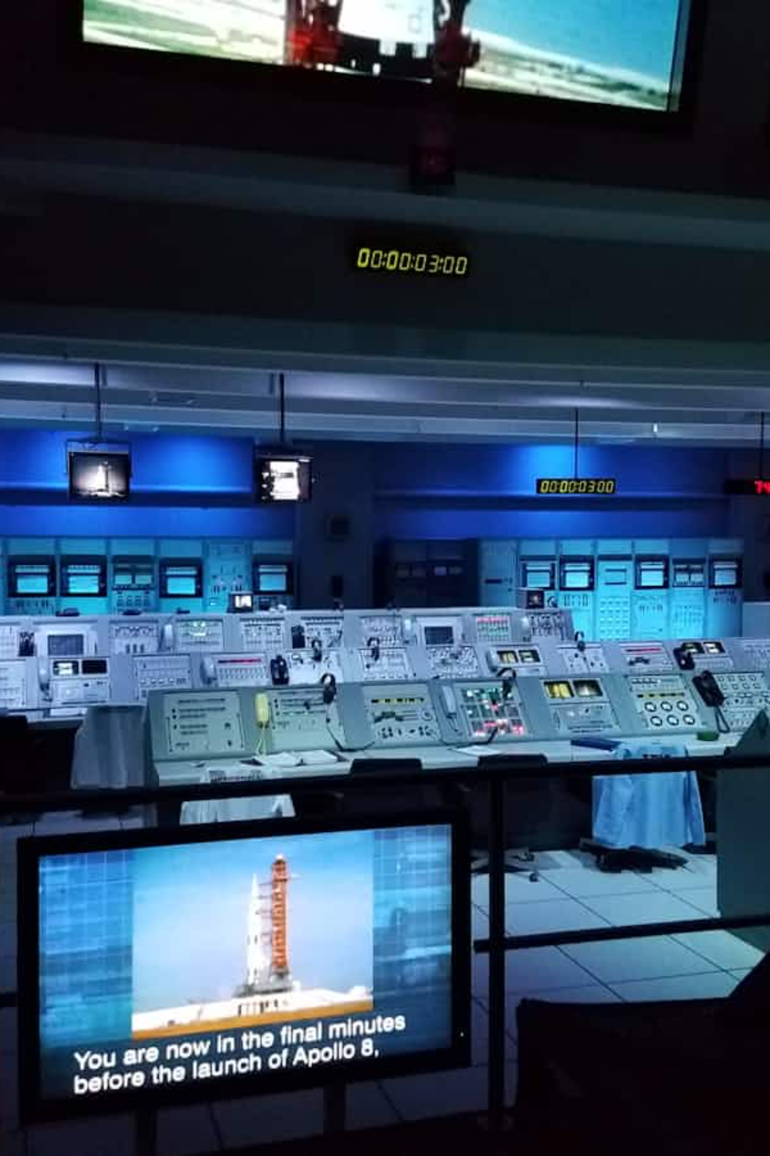

Future Work
If we had more time, we would enhance SPACE++ with additional features:
Space Weather Integration
Geodetic Information
Nearby cities, visibility duration, next visibility times.
Solar flares, radiation, storms, meteor/satellite collision detection.

Slide 7
Thank You
Questions?

Slide 8
References
CelesTrak, www.celestrak.org
Space-Track, www.space-track.org
MDA Space. “Your Trusted Space Mission Partner.” MDA Space, mda.space
Canadian Space Agency. “Canadian Space Agency (CSA) - Space Science & Space Technology.” Canadian Space Agency, / Gouvernement du Canada, 26 Sept. 2025, www.asc-csa.gc.ca

